Slide 1
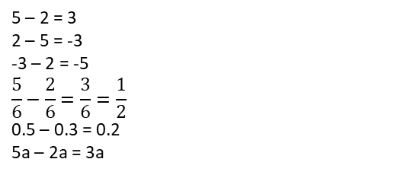
Subtopic N2.6 – Use Formal Methods for Subtraction of Integers
LEARNING OUTCOME: To understand how to subtract integers.
Keywords:
Subtract
Difference
Exchange
Objectives:
To use the column method for simple subtraction.
To use the column method for subtraction involving exchanging.
Introduction – Read and annotate:
Column subtraction is a written method used to subtract one whole number from another by lining
up the digits according to place value. Like with column addition, it is important to keep the columns
straight so that each digit is subtracted from the correct place, starting from the right and using
exchanges when needed.
Definition
Characteristics
A mathematical operation in which the difference between two numbers or quantities is calculated.
• Can involve positive or negative integers, fractions, decimals, percentages or algebraic terms.
• Linked words include minus, difference.
Examples
Subtraction
Non - Examples
Words that aren’t linked to subtraction:
• Sum: When you're asked to find the "sum" of numbers, you're being asked to add them, not subtract. For example, the sum of 8 and 6 is 14, which is not a subtraction
• Compare: When comparing numbers to determine which is larger or smaller, you are not performing a subtraction. For example, comparing 10 and 5, you know that 10 is greater, but this doesn't involve a subtraction operation
Column subtraction (no exchanging required)
For the following questions, use the column method to work out the subtraction problems:
Steps | 83 – 52 | 96 – 24 | 45 – 32
1) Write the numbers in columns, ensuring that they are lined up correctly. | 31 | 72 | 13
2) Starting from the ones column, complete subtraction.
Example 2 – We do…
Example 1 - I do…
Example 3 – You do…

Slide 2
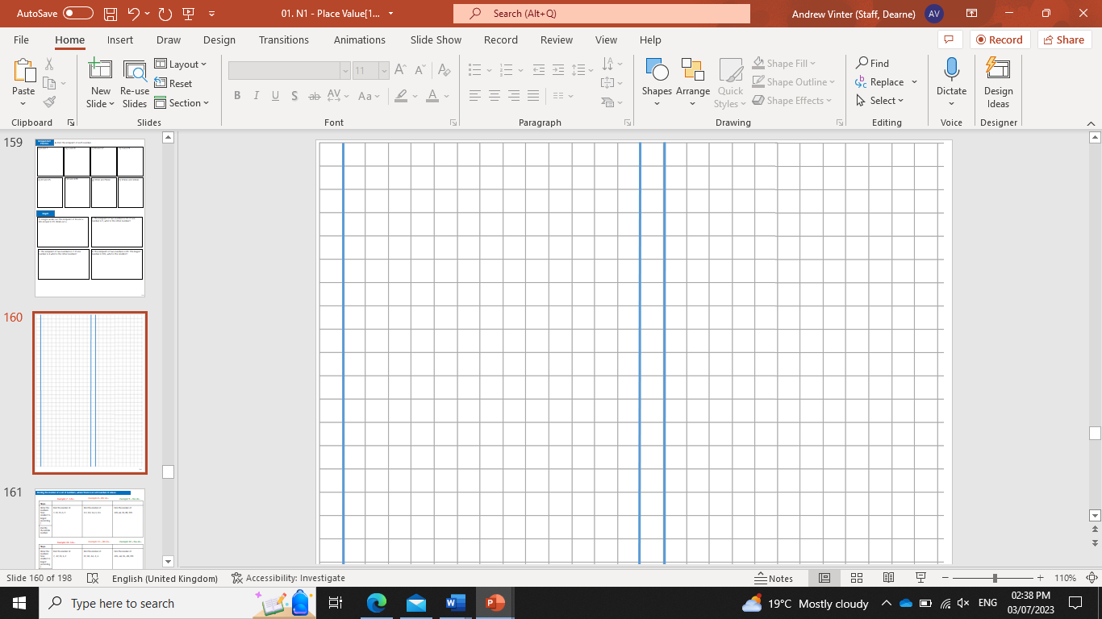
Steps | 5183 – 52 | 4782 – 41 | 3494 - 23
1) Write the numbers in columns, ensuring that they are lined up correctly. | 5131 | 4741 | 3471
2) Starting from the ones column, complete subtraction.
Example 5 – We do…
Example 4 - I do…
Example 6 – You do…
Independent Practice
1. Use the column method to work out the subtraction problems:
a) 79 – 22 | b) 89 – 22 | c) 89 – 11
d) 89 – 17 | e) 19 – 17 | f) 99 – 17
g) 197 – 12 | h) 297 – 12 | i) 297 – 61
57 77 78
72 2 82
185 285 236
j) 298 – 91 | k) 298 – 71 | l) 497 – 71
m) 785 – 512 | n) 859 – 132 | o) 559 – 319
207 227 426
273 727 240

Slide 3
p) 946 – 230 | q) 4854 – 1132 | r) 4871 – 1540
s) 5792 – 4431 | t) 4781 – 1650 | u) 48832 – 14501
736 3722 3331
1361 3131 34331
Column subtraction (exchanging required)
For the following questions, use the column method to work out the subtraction problems:
Steps | 94 - 36 | 62 - 28 | 53 - 39
1) Write the numbers in columns, ensuring that they are lined up correctly.
2) Starting from the ones column, complete subtraction.
3) Exchange where appropriate.
Example 7 - I do…
Example 8 – We do…
Example 9 – You do…
58
34
14
For the following questions, use the column method to work out the subtraction problems:
Steps | 3417 - 58 | 6423 – 49 | 7342 - 95
1) Write the numbers in columns, ensuring that they are lined up correctly.
2) Starting from the ones column, complete subtraction.
3) Exchange where appropriate.
Example 10 - I do…
Example 11 – We do…
Example 12 – You do…
7247
6384
3359

Slide 4
Independent Practice
2. For the following questions, use the column method to work out the subtraction problems:
a) 64 – 27 | b) 78 – 29 | c) 92 - 38
d) 105 – 83 | e) 123 – 89 | f) 150 - 62
37 49 54
22 34 88
g) 156 - 74 | h) 187 – 105 | i) 249 - 173
j) 267 – 194 | k) 312 – 187 | l) 398 - 256
m) 1452 - 898 | n) 3249 - 1675
82 82 76
73 125 142
554 1574

Slide 5
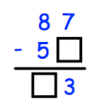
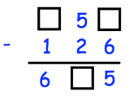
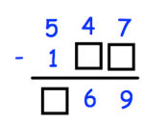
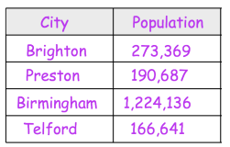


3. Sarah buys an apple for 41p and a banana for 27p. How much more expensive is an apple than a banana? | 4. Kelly has 76 marbles and Hannah has 102 marbles. How many more marble does Hannah have than Kelly?
5. At a football match there are 2942 Rovers fans and 9381 City fans. How many more fans did City have? | 6. Theo wants to buy a laptop that costs £425. Theo has saved £267 so far. How much more money does Theo need to save?
14p
26p
£158
6439
7. For the following questions, fill in the missing numbers.
8. This table shows the number of people living in various cities in England. How many more people live in Birmingham than Preston?
7
1
4
7
8
3
2
3
1,033,449
9. Work out the difference between 234,789 and 502,113
267, 324
10. For the following questions, fill in the missing numbers.
a) | b)
108
266

Slide 6
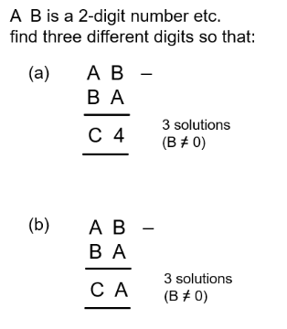
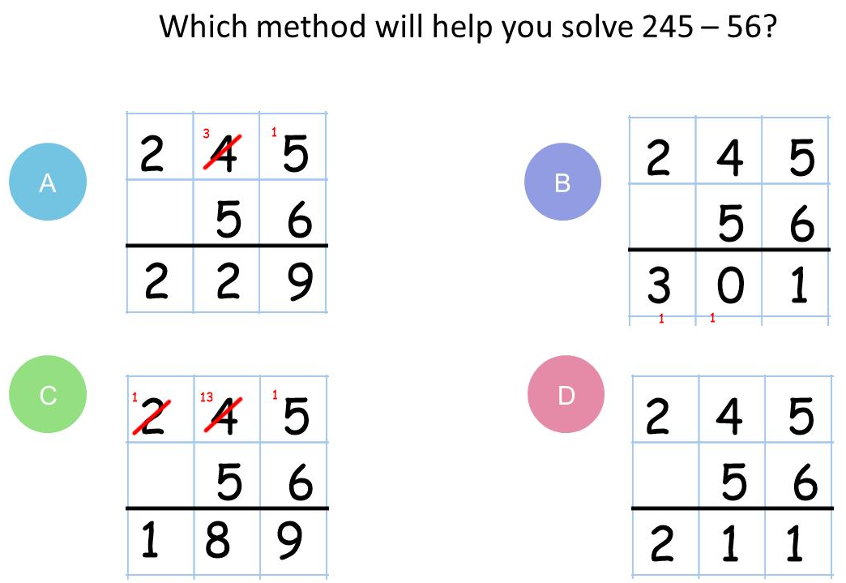
12. A B is a 2-digit number etc. Find three different digits
a) 3 solutions B ≠ 0 | b) 3 solutions B ≠ 0 C ≠ 0
A = 9, B = 3, C = 5 A = 8, B = 2, C = 5 A = 7, B = 1, C = 5 | A = 6, B = 2, C = 3 A = 7, B = 4, C = 2 A = 8, B = 6, C = 1
Skills Check

